Slide 1
By: Justin Perrotta
Bradley Small
Zack Czarcecki
Kimberly Small
Wei Min Lee

Slide 2
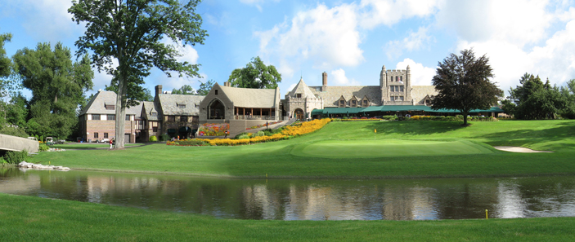
Country Club Official Website
http://parkcountryclub.weebly.com/

Slide 4
Questions?

